Slide 1

Support Vector Machine
Afsana alam
Sabbir ahmed
Farhan siddiques Sadi

Slide 2
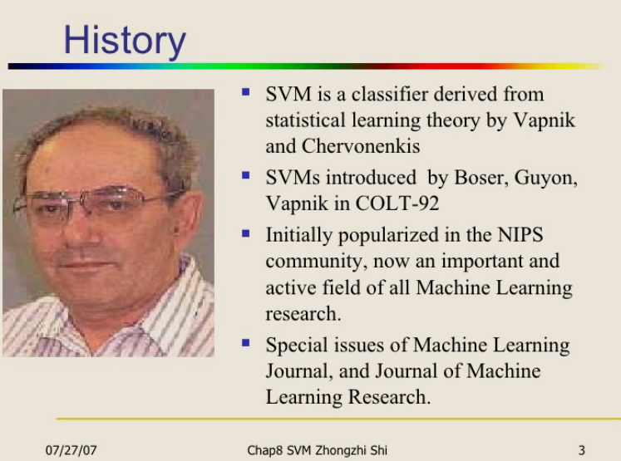
History

Slide 3
What is SVM?
SVM is a supervised learning algorithm which is widely used classification algorithm.
SVM is applicable for the data that are linearly separable
For non-linear data, kernel functions are used

Slide 4
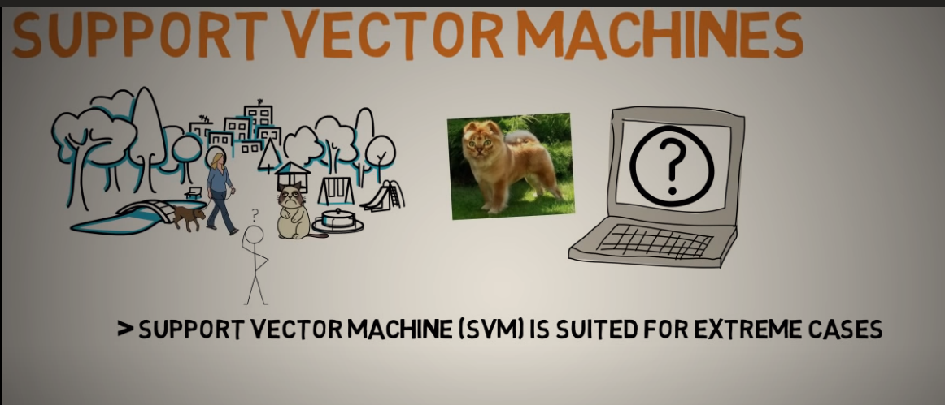
What is SVM?

Slide 5
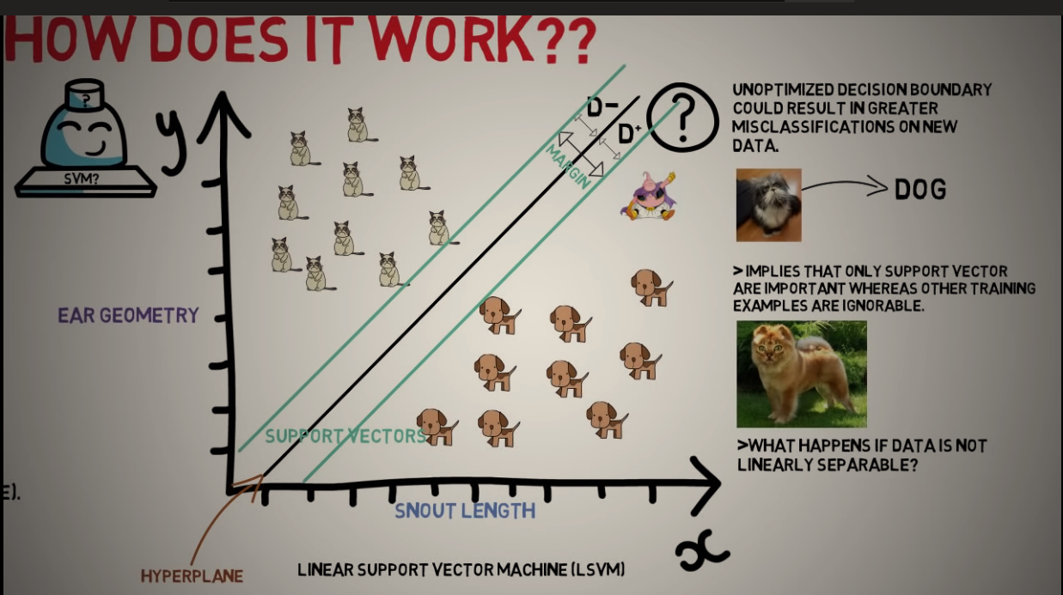
Linear svm

Slide 6
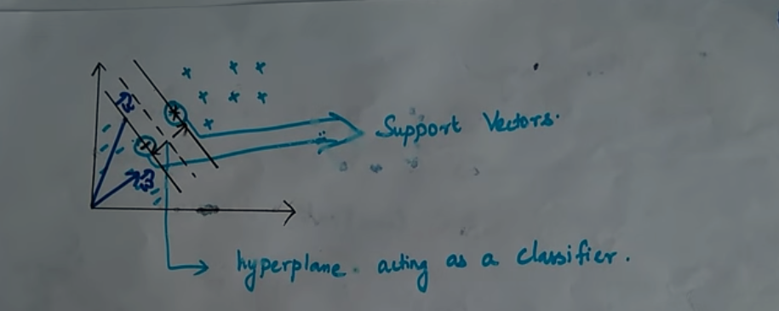
SVM hyperplane

Slide 7
SVM hyperplane
SVM classifies the two classes using “hyperplane”. This hyperplane should have the largest margin in high-dimensional space to separate the given data into classes.
The margin between the 2 classes represents the longest distance between the closest data points of those classes

Slide 8
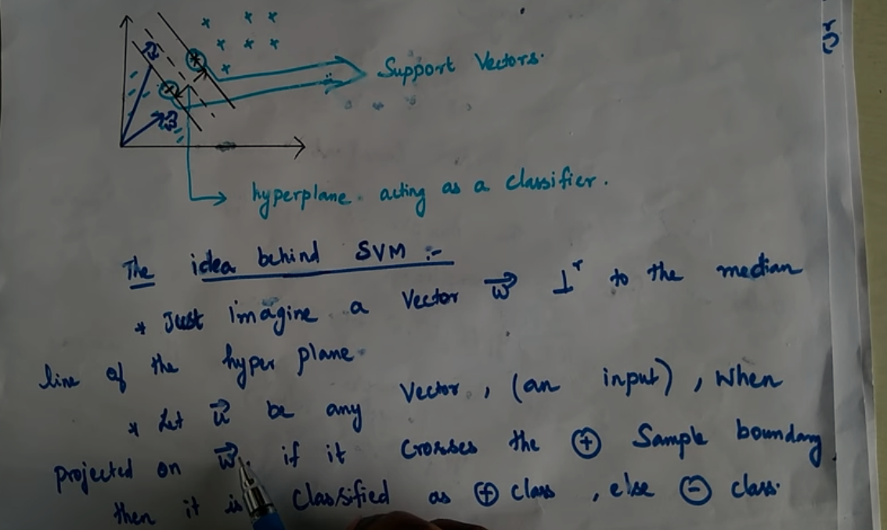
Mathmatical Explanation

Slide 9
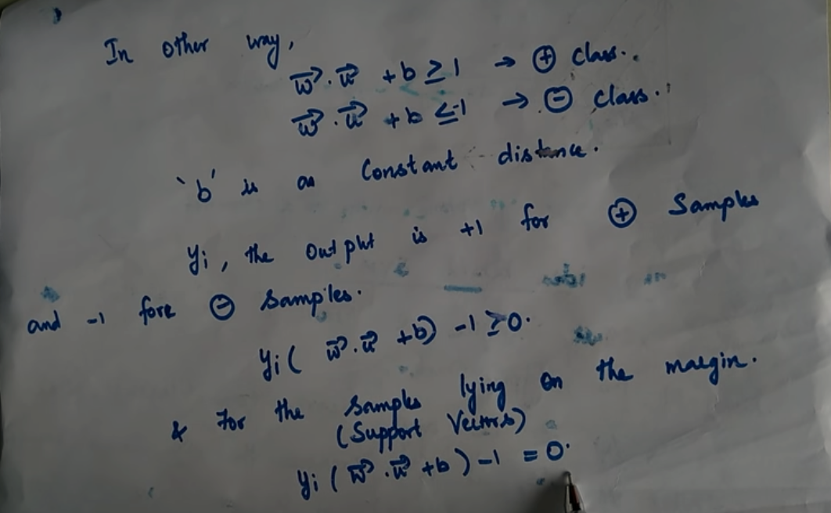
Mathmatical explanation

Slide 10
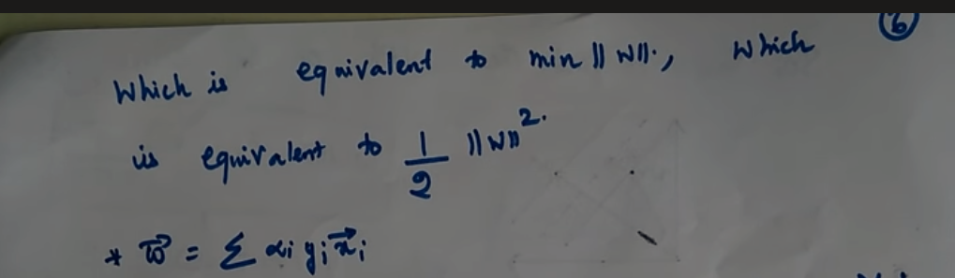
Mathmatical Explanation

Slide 11
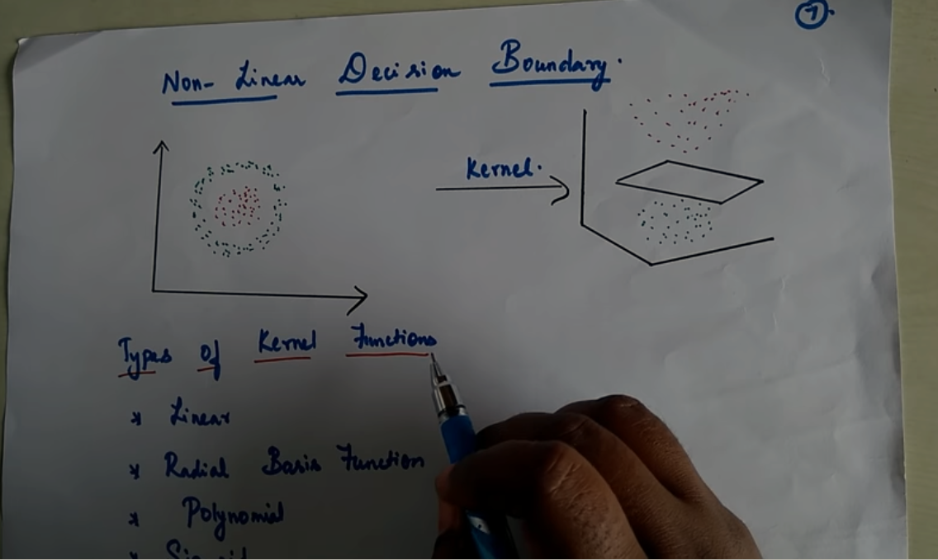
Non-Linear SVM

Slide 12
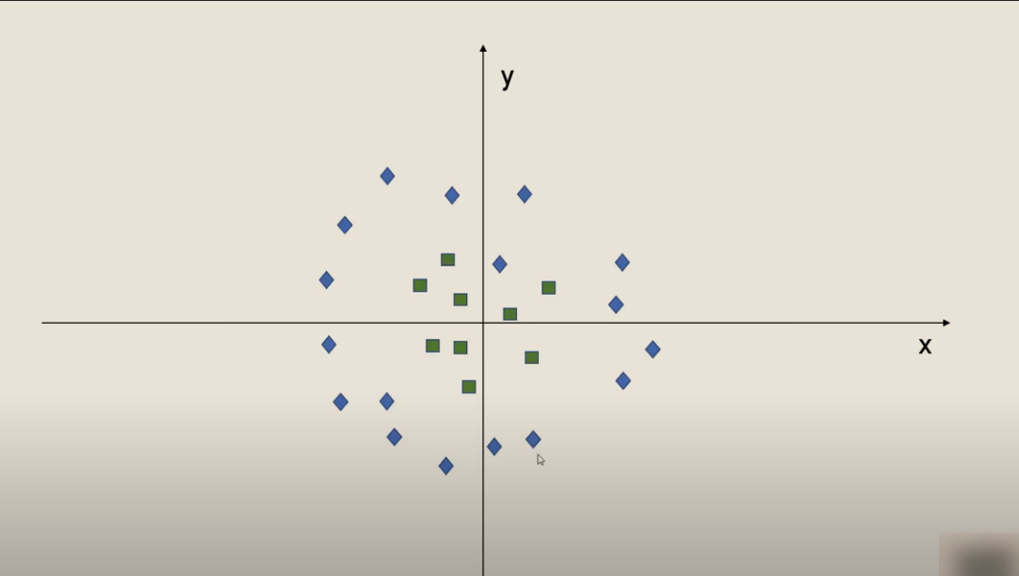
Non-linear

Slide 13
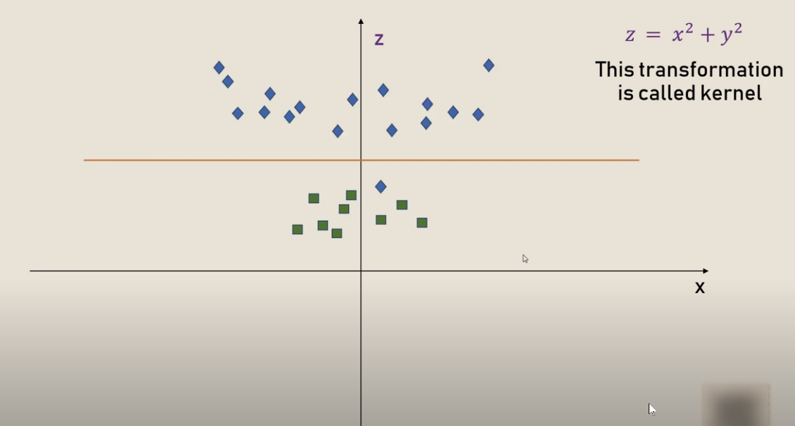
Non-linear

Slide 14
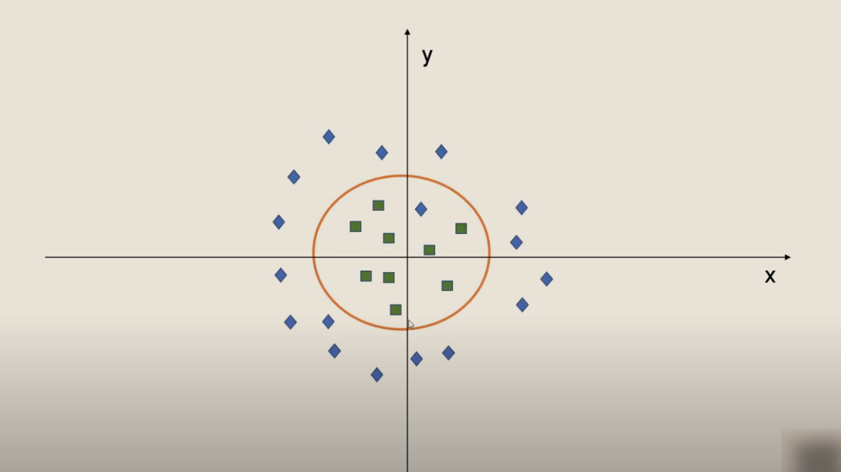
Non-linear

Slide 15
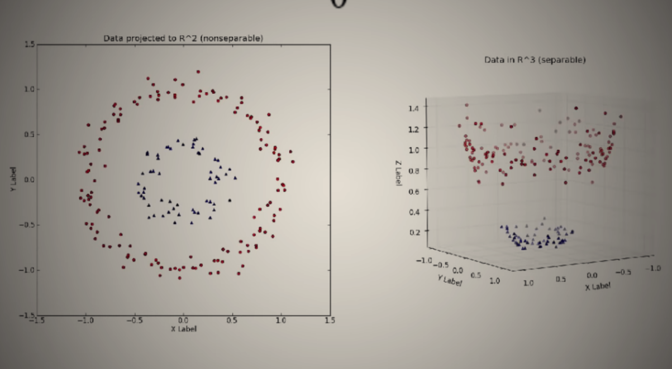
Non-linear

Slide 16
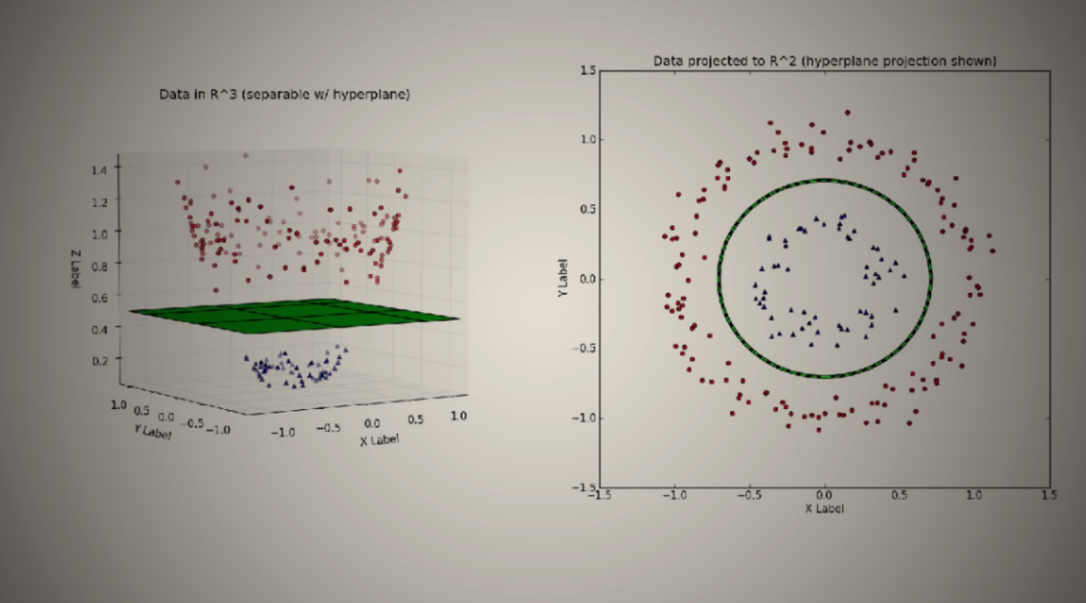
Non-linear

Slide 17
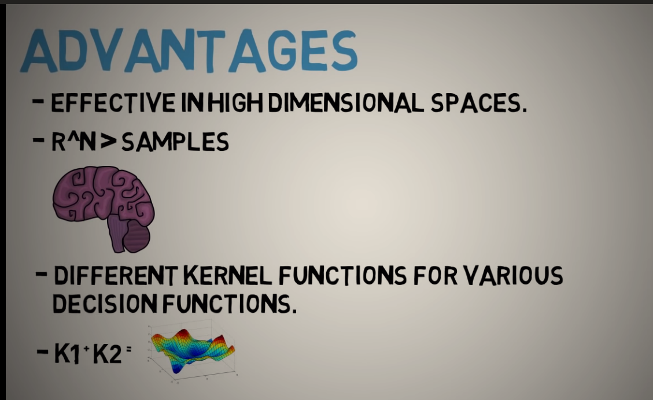
Advantages

Slide 18
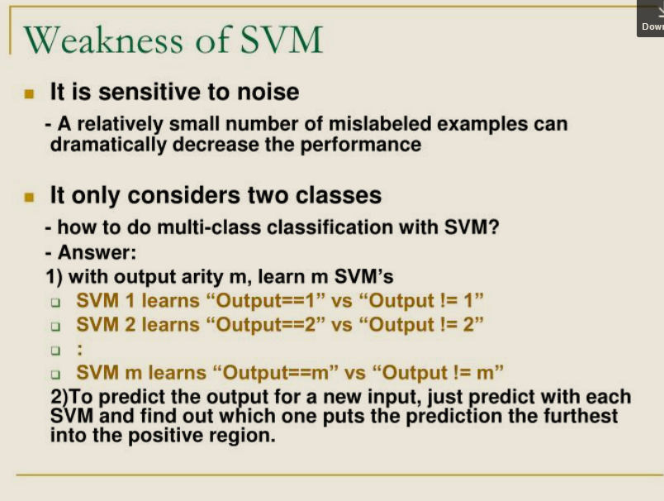
Disadvantages

Slide 19
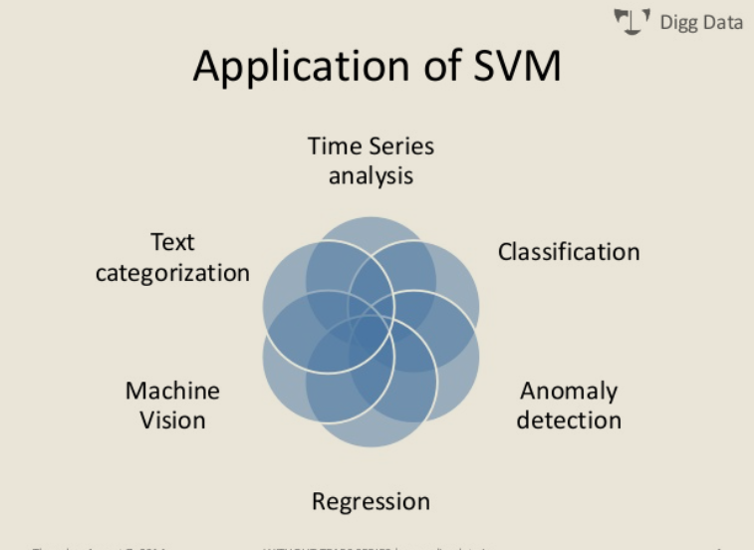
Application

Slide 20
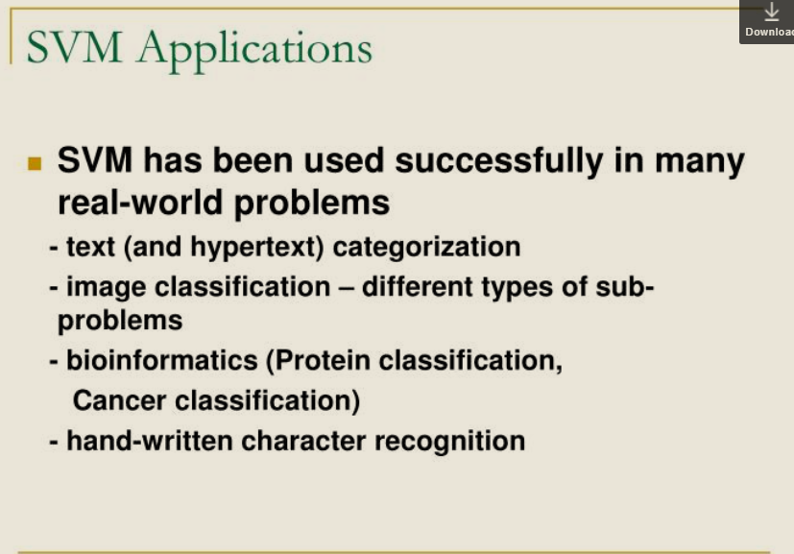
Application

